Slide 1
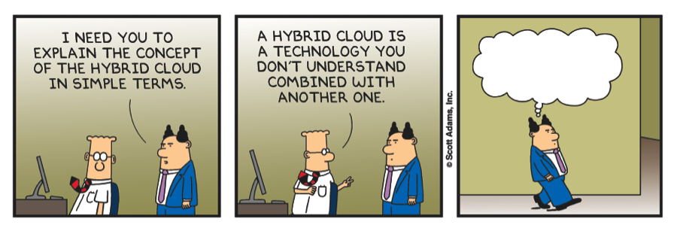
Mjr-dotnet
Distributed architectures

Slide 2
Agenda
Principles of Microservices
Break
Akka.net @Acerta: Kris Schepers
Service fabric: Nick Verschueren
What is next?

Slide 3
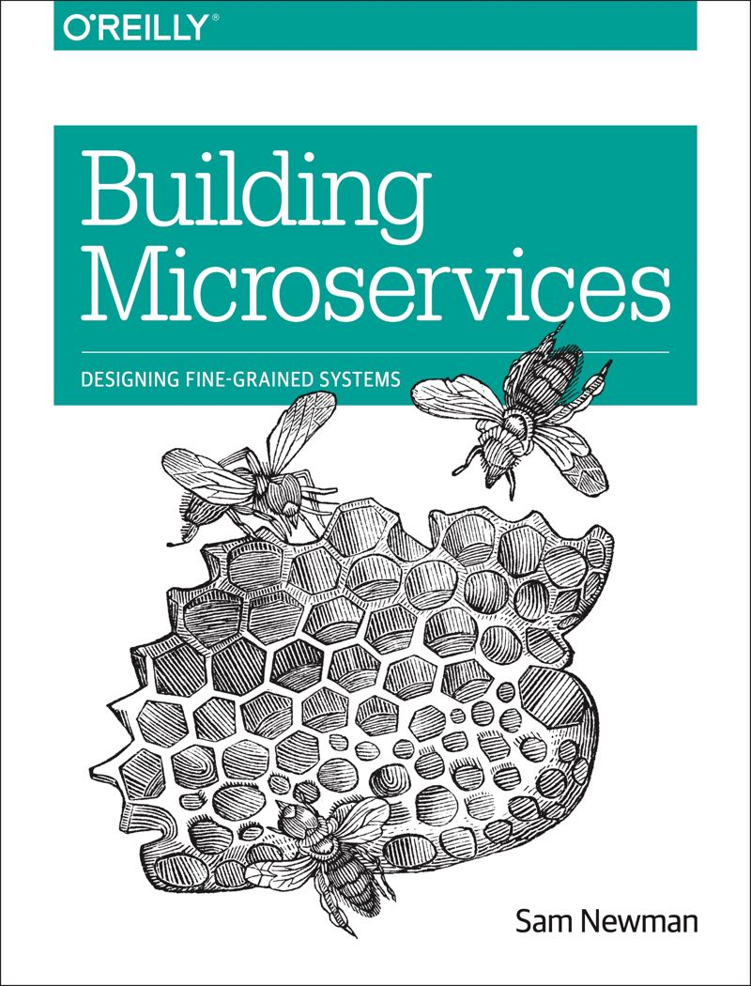
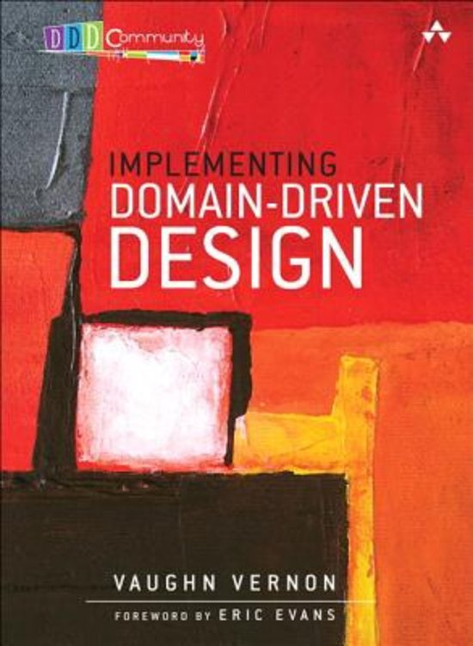
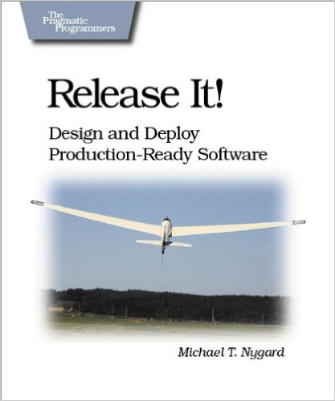
Books

Slide 4
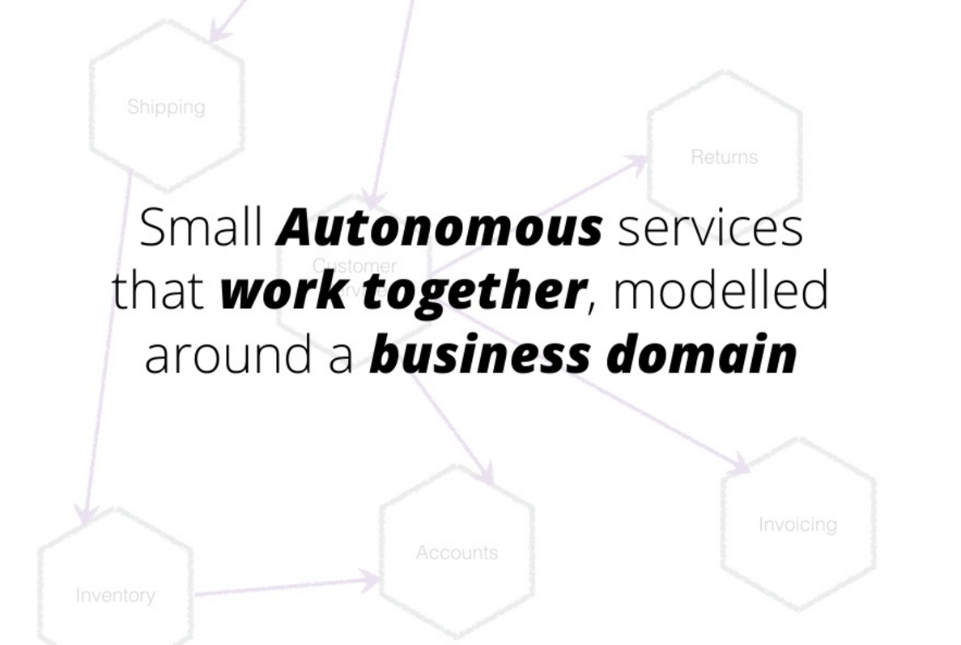
Microservices definition
Sam Newman – Building microservices

Slide 5
Principles of Microservices
Modelled Around Business Domain
Culture of Automation
Hide Implementation Details
Decentralise All the Things
Deploy Independently
Customer First
Isolate Failure
Highly Observable
Sam Newman – Building microservices

Slide 6
Modelled Around Business Domain
View Unapproved Invoices
Approve Invoice
Reject Invoice
UI Layer
Domain Objects
Repository
Database
Jimmy Bogard’s - SOLIDArchitecture

Slide 7
Modelled Around Business Domain
Logging
Authentication
Exception handling
Feature
Feature
Feature
Feature
Feature
Feature
Feature
Feature
Feature
Feature
Feature
Feature
Feature
Feature
Persistence
Jimmy Bogard’s - SOLIDArchitecture

Slide 8
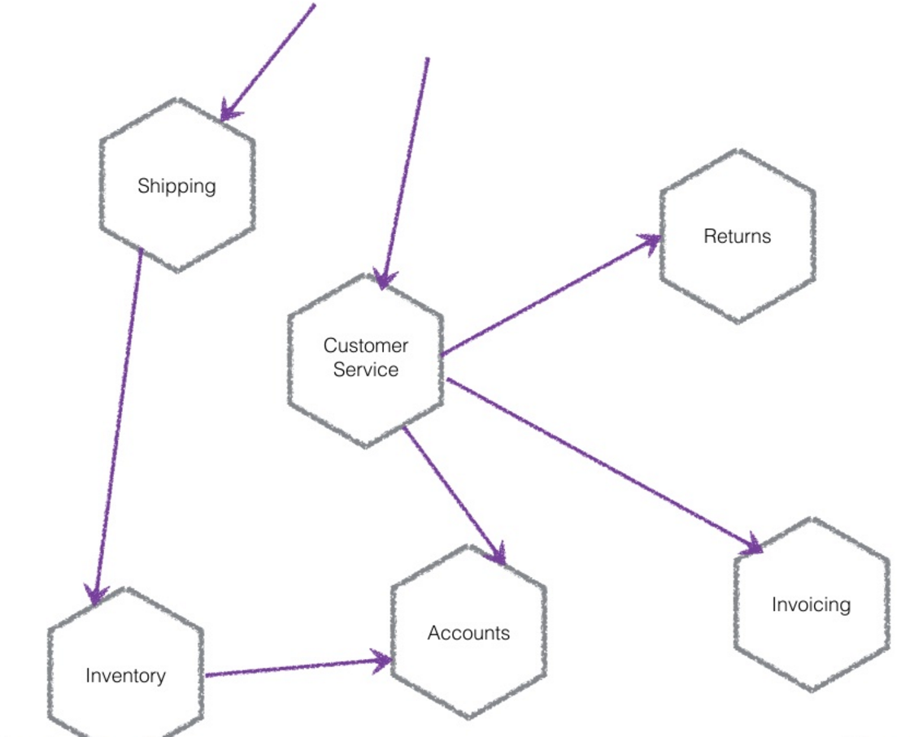
Modelled Around Business Domain
Sam Newman – Building microservices

Slide 9
Culture of automation
Infrastructure automation
Automated testing
Continous delivery

Slide 10
Hide implementation details
Hide you database

Slide 11
One db
Table per service
Schema per service
Database per product
Distribute your data model -> you use the api more

Slide 12
Db per service
Looks good on paper
Data aggregation problems
Joins -> application joins
Distributed Transactions are hard
Increased maintenance

Slide 13
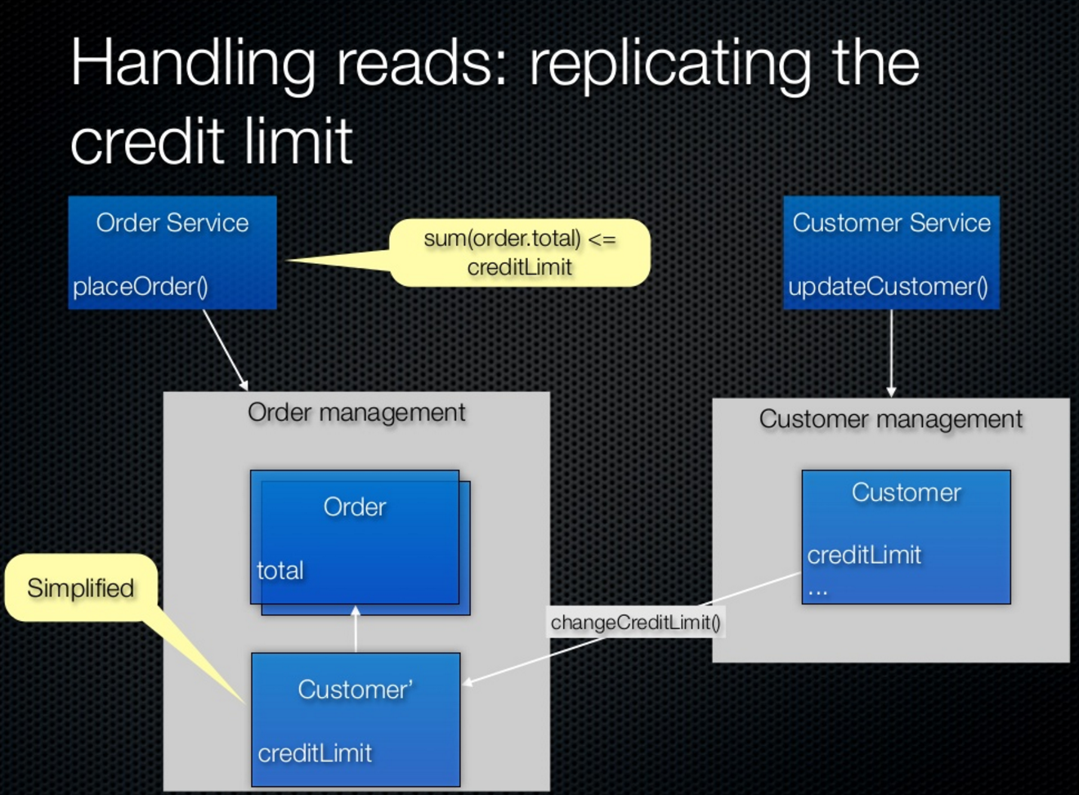
Data pumps

Slide 14
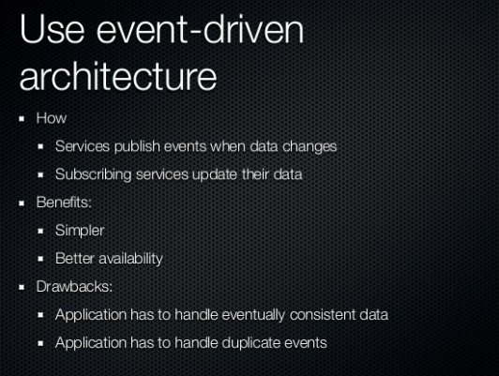
Event Sourcing

Slide 15
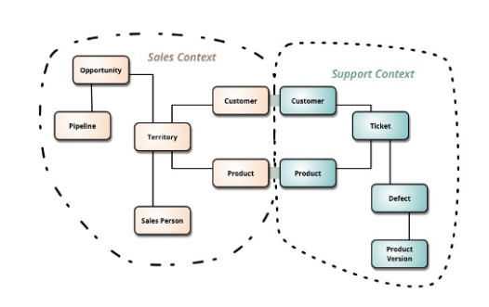
Hide implementation details

Slide 16
Decentralize all the things
Give people as much freedom as possible to do the job at hand
Internal open source
Delegate decision making
Align teams to the conway’s law of organization
Or use shared governance

Slide 17
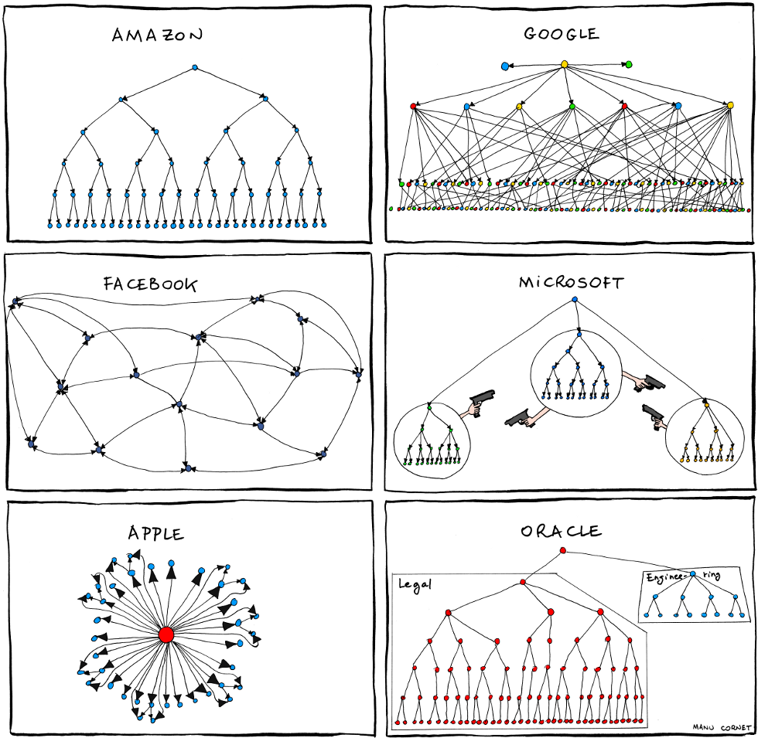
Conway’s Law
Any organization that designs a system will inevitably produce a design whose structure is a copy of the organization's communication structure.

Slide 18
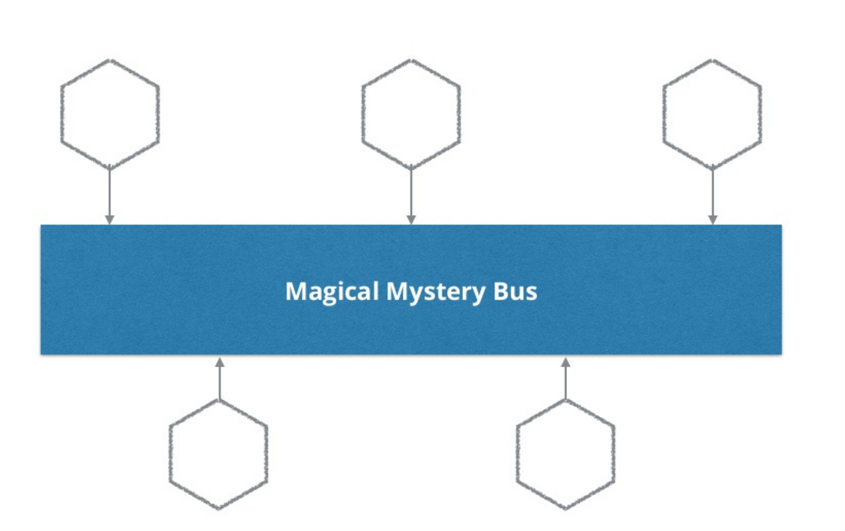
Dumb-Pipes, smart endpoints

Slide 19
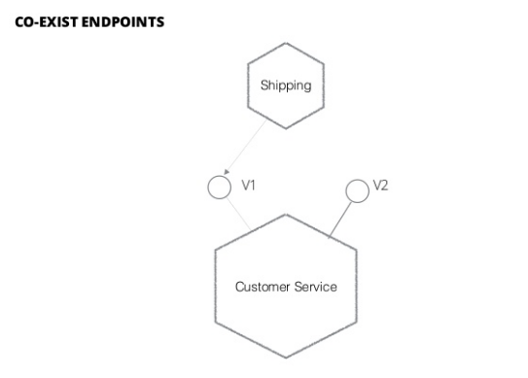
Deploy independently

Slide 20
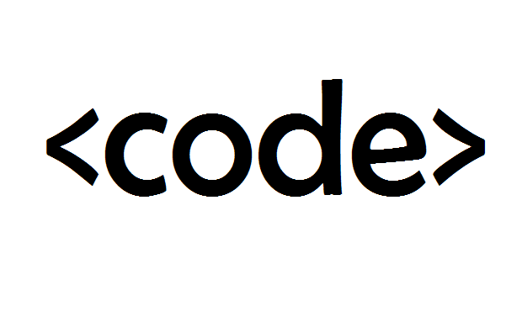
Consumer driven contracts

Slide 21
Consumer first
Think like the consumer (not only UI)
Swagger
Service discovery tools

Slide 22
Isolate failure
Plan for failure
Antifragility
Timeouts
Bulkheads
Circuit breakers
Fail fast

Slide 23
High observable
Monitoring
Simulate real-user behavior
Aggregate logs and statistics
Use correlation id’s

Slide 24
Principles of Microservices applied
Modelled Around Business Domain
Analyse
Culture of Automation
Tools (Bladelogic, IIS install framework)
Hide Implementation Details
Use REST
Decentralise All the Things
organizational, prefer choreography over orchestration
Deploy Independently
Semantic versioning + Consumer driven contract
Consumer First
Swagger / service discovery tools
Isolate Failure
antifragility (timeouts, bulkheads, circuit breakers)
Highly Observable
aggregate logs (dynatrace)

Slide 25
Monolithic feature driven architecture
IoC
Logging
Authentication
Exception handling
Infrastructure configures middleware
MVC
Validation Filter
Exception Filters
UsersController
MediatR
AddUser
GetUsers
Command
Query
Handler
Handler
Features in plain C#
Result
Result
Mapping
Mapping
Persistence
Entities drive db changes
with data migrations

Slide 26
Microservices
Web
Web
Web
Mobile
Mobile
Mobile
Api
Api
Api
Logging
Messaging
Discovery
Provisioning
Monitoring

Slide 27
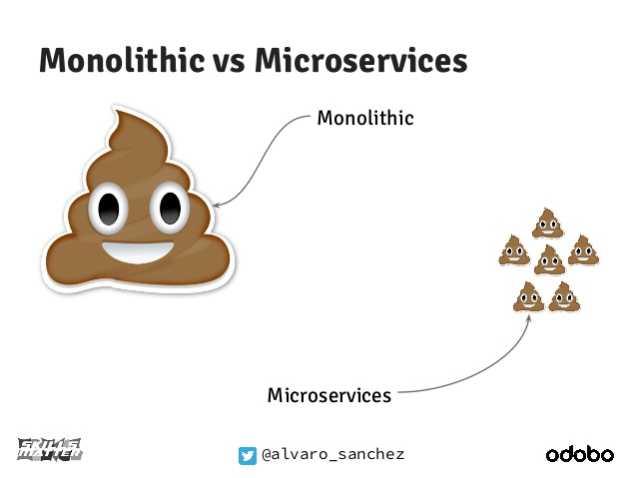

Slide 29
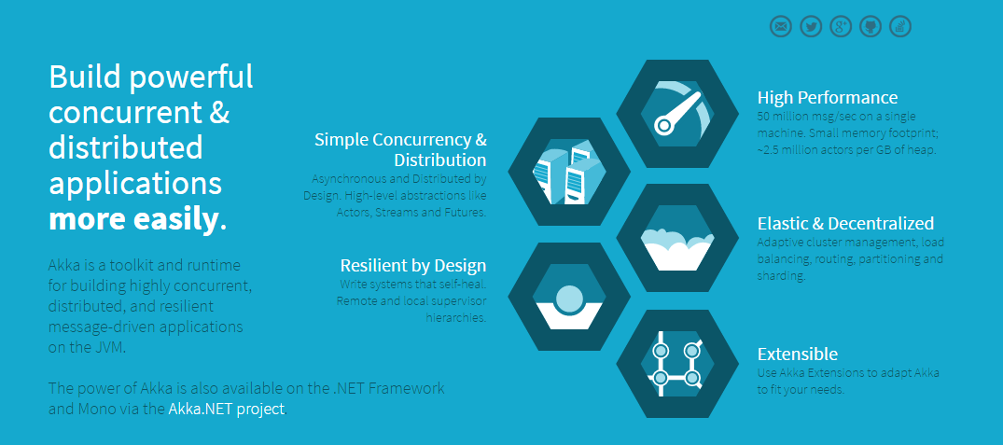
What is Akka?

Slide 30
Axes of change
View Unapproved Invoices
Approve Invoice
Reject Invoice
UI Layer
Domain Objects
Repository
Database
Jimmy Bogard’s - SOLIDArchitecture

Slide 31
Web App Characteristics
Web App
Safe
Idempotent
Unsafe
Not idempotent
GET
Query
POST
Command
Jimmy Bogard’s - SOLIDArchitecture

Slide 32

Modeling requests
Input
Request Handler
Output
Jimmy Bogard’s - SOLIDArchitecture

Slide 33
Testing

Slide 34


Slide 35
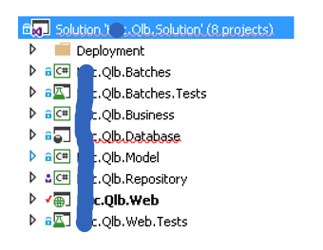
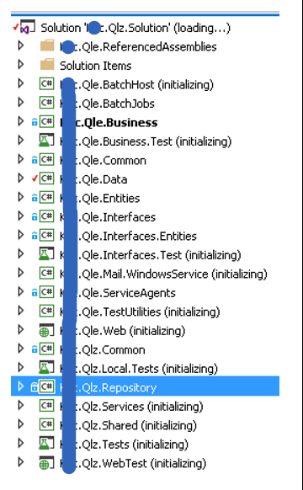
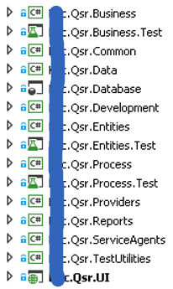
Legacy or reality
# applications
Framework
Updated via
Nuget

Slide 36
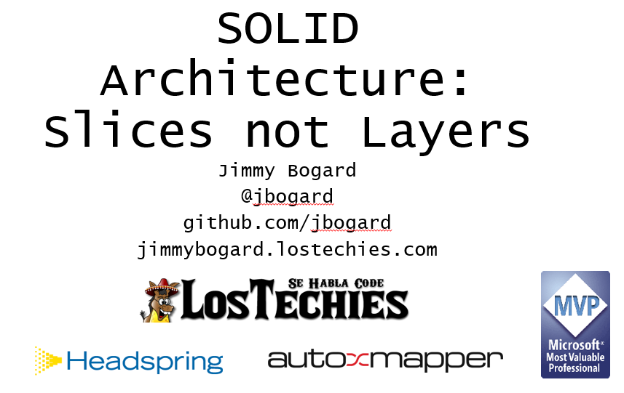

Slide 37
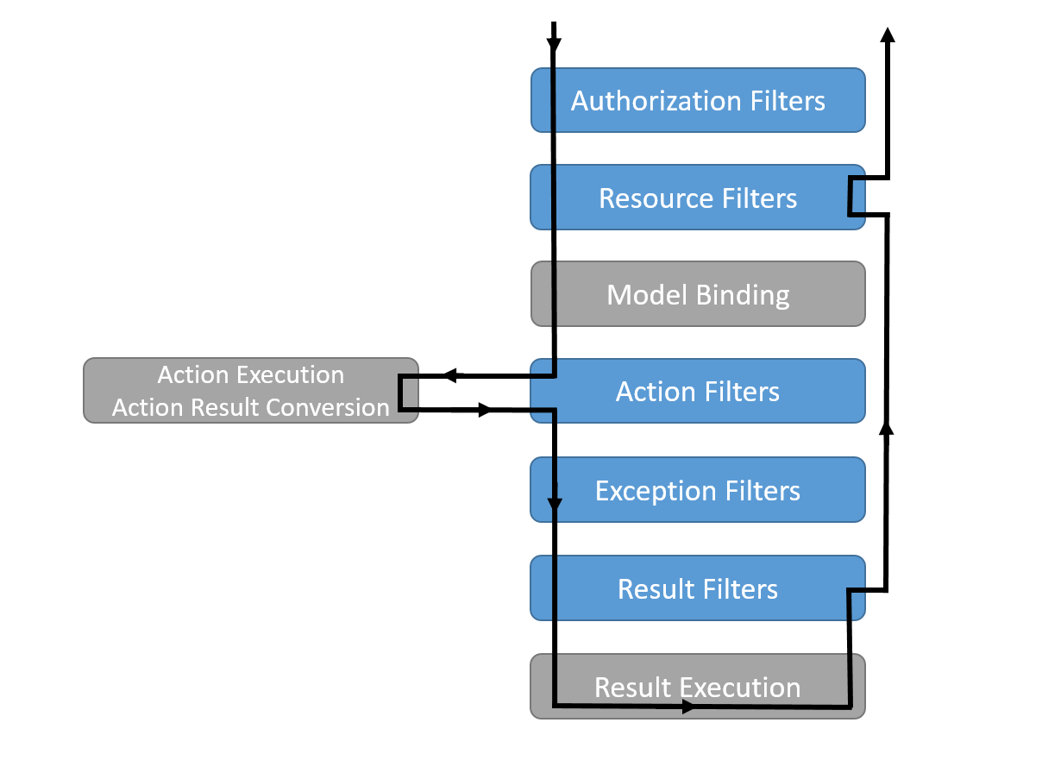
Mvc Middleware

Slide 38
Feature driven
Logging
Authentication
Exception handling
Feature
Feature
Feature
Feature
Feature
Feature
Feature
Feature
Feature
Feature
Feature
Feature
Feature
Feature
Persistence
Jimmy Bogard’s - SOLIDArchitecture

Slide 39
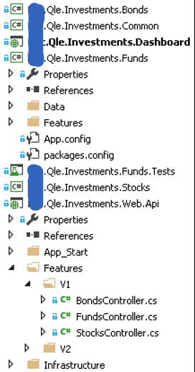
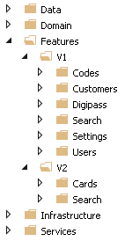
Organizational benefits
Version per feature (or not)
Dedicated teams per feature
Deployment per feature

Slide 40
Feature driven architecture
IoC
Logging
Authentication
Exception handling
Infrastructure configures middleware
MVC
Validation Filter
Exception Filters
UsersController
MediatR
AddUser
GetUsers
Command
Query
Handler
Handler
Features in plain C#
Result
Result
Mapping
Mapping
Persistence
Entities drive db changes
with data migrations

Slide 41
Integration tests
IoC
Logging
Authentication
Exception handling
Infrastructure tests where needed
MVC
Validation Filter
Exception Filters
UsersController
MediatR
AddUser
GetUsers
Command
Query
Feature integration tests
IoC without Mvc
Start point mediatr
Autofixture: generation objects
Specific test DB
Respawn clears db before test run
Handler
Handler
Result
Result
Mapping
Mapping
Persistence

Slide 42
On run of a unit test
Fixie scans all files and detects classes that end on 'tests' and public methods as tests to run.
Fixie triggers setup of Autofixture
Autofixture has a custimization that
Setups the IoC container
Registers all types of the requesthandler
Registers all automapper profiles
Registers the unittestDbContext
Before Fixie call's the method to run
The DeleteData fixie convention is executed
Respawn clears the database by using delete statements
All method parameters are resolved using Autofixture

Slide 43
Structuremap Lifecycles
Transient
The default lifecycle. A new object is created for each logical request to resolve an object graph from the container.
Singleton
Only one object instance will be created for the container and any children or nested containers created by that container
ContainerScoped
Only one object instance will be created for unique root, child, or nested container
UniquePerRequest
The same instance will be shared within a resolved object graph, but if we resolve the same root type once more, we will get a new shared instance - a Singleton local to that graph.

